Slide 2
Previously… Workshop 1
Workshop 1
Brainstorm and identify relevant subject-specific digital competencies for future graduates from your degree program.
Categorise competencies in meaningful clusters.
Formulate suggestions for a shared subject-specific digital competency profile for the degree program.
PROGRESSION
Workshop 2

Slide 3
Aim of this workshop Workshop 2
Workshop 1
Workshop 2
Explore opportunities to integrate digital competencies into your programme.
Learn about different curriculum approaches.
Identify initiatives for implementation, assess potential obstacles, and develop strategies to overcome them.
PROGRESSION

Slide 4
Revisiting Workshop 1 model for Digital Competencies
GETTING STARTED
PAIR
10 min
Revisit the Model for Digital Competencies you developed during Workshop 1. Reflect on the following questions:
Have any new insights emerged since the first workshop?
Are there any skills/competencies that need to be added, removed, or revised?
Are certain digital competencies more critical or applicable to your specific program compared to others?

Slide 5
Revisiting Workshop 1 model for Digital Competencies
GETTING STARTED
GROUP
10 min
Share with the whole group:
Highlight one or two things you've added or removed from your Model for Digital Competencies?

Slide 6
Curriculum design approaches
There are several ways to integrate (digital) competencies into your curriculum, each with its own advantages and challenges.
Here are 5 examples of approaches you can take:
Extra-Curricular Approach
Integrated Curriculum Approach
Distributed Curriculum Approach
Multi-Program Approach
Combined Approach

Slide 12
Some considerations to keep in mind
There are various ways to integrate digital competencies into your curriculum, each with its own pros and cons. Consider:
Are the integrated elements coherent and coordinated across courses?
How do digital components relate to the rest of the curriculum?
Can the value of these competencies be clearly explained?
Does the academic community have the skills needed?
Is there enough student interest for electives or extracurriculars?
If electives are cross-curricular, do they meet the needs of your students?

Slide 13
Curriculum Lines
Curriculum commonly refers to the pathway or progression of a course or program.
Through curriculum lines, you can track how competencies, skills, and knowledge develop throughout a program.
Visualizing these pathways helps identify areas for improvement and reveals coherence —or gaps—In the structure of the study program.
From “Curriculum.” Merriam-Webster.com Dictionary, Merriam-Webster, https://www.merriam-webster.com/dictionary/curriculum. Accessed 30 Oct. 2024.

Slide 14
Curriculum lines Exercise instructions – Part 1
EXERCISE
SMALL GROUPS
20 min
Choose a competency from the program-level of your Model for Digital Competencies and assign it a colour. If you previously chose to draw on the DigComp 2.2 Framework, it may be easiest to use the colour of the competency category.
Identify in which course(s) this competency is located by marking it with sticky notes in the course diagram. Remember to add extracurricular elements where relevant.

Slide 16
Curriculum lines Exercise instructions - Part 2
EXERCISE
SMALL GROUPS
20 min
Consider:
Are these competencies revisited in other courses? Are there prior courses that cover or should cover the same or similar topics?
In which course(s) could/should these competencies be revisited by students?
What connections or pathways do you see or wish to establish?

Slide 17
Sharing back Curriculum lines Exercise
GROUP
10 min
Share your insights with the group:
Where are competencies currently included in your program? Where are they missing?
Where might they benefit from more or less focus?
Discuss possible curriculum changes, including new electives or extracurricular opportunities.

Slide 18
Initiatives, Barriers, and Solutions
EXERCISE
SMALL GROUPS
20 min
Based on insights from the curriculum review, suggest ways to integrate/revise competencies into the program (e.g., new topics, activities, courses, or electives). Consider:
Current Barriers: What challenges might arise, like limited faculty expertise or lack resources?
Potential Solutions: How could you address these challenges, such as through faculty training or curriculum updates?
Document your discussion in the Initiatives Handout (see next slide).

Slide 19
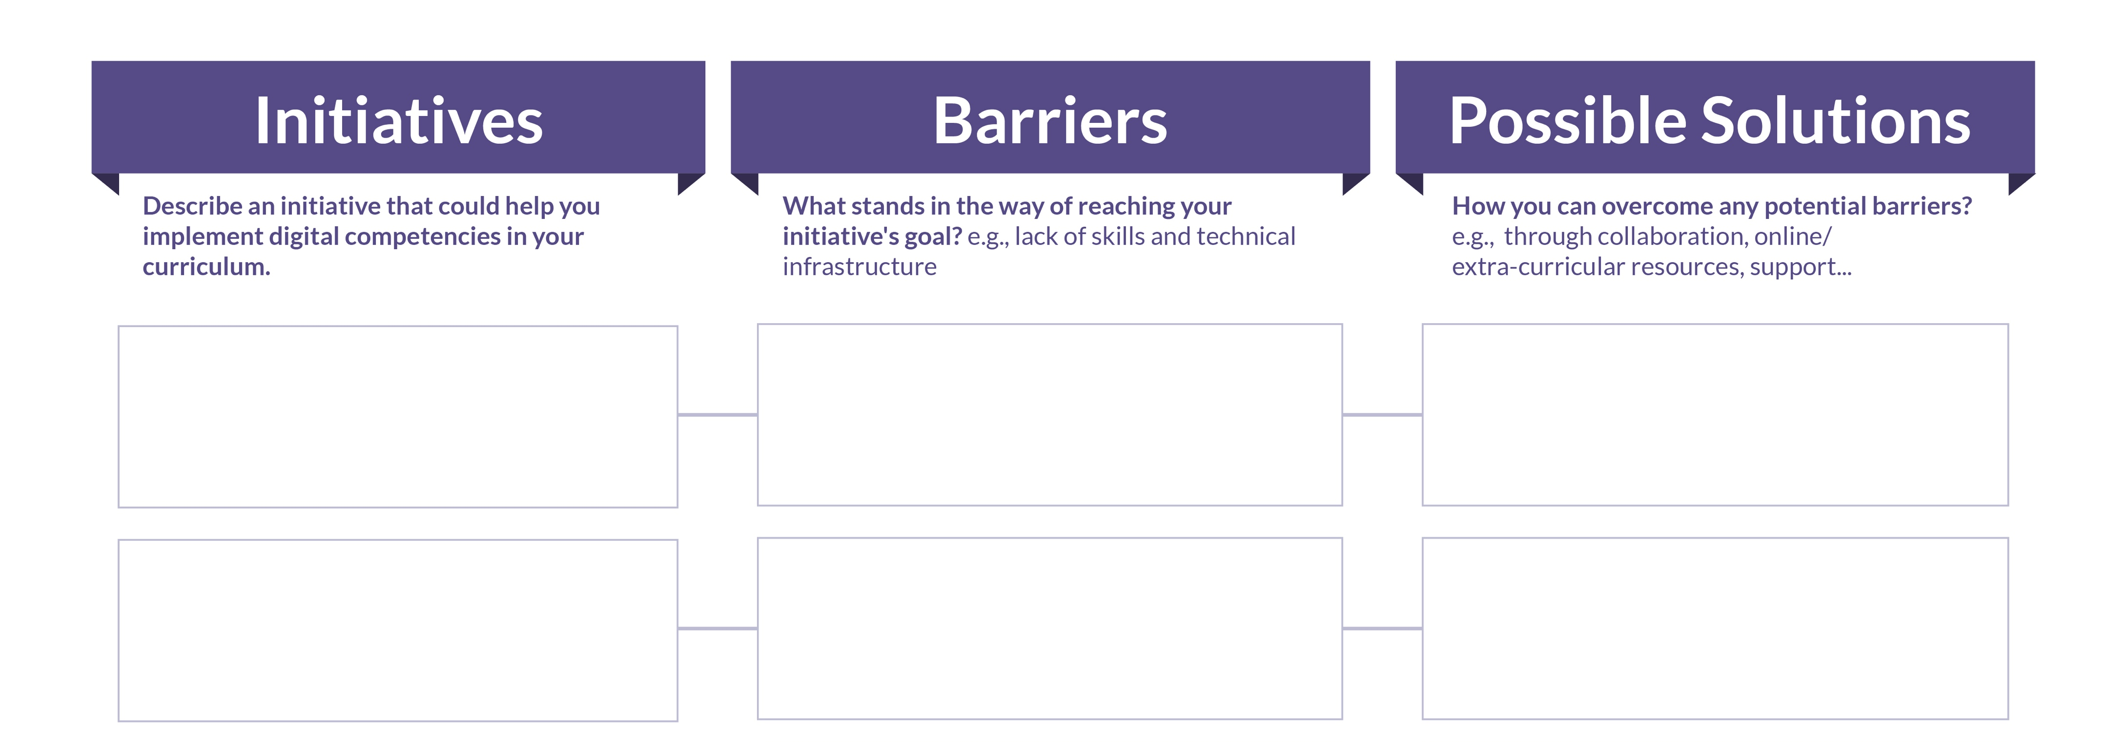
Initiatives, Barriers, and Solutions
EXERCISE
SMALL GROUPS
20 min

Slide 20
Sharing your discussions Initiatives, Barriers, and Solutions
EXERCISE
GROUP
10 min
Share your key initiatives with the group:
Which initiative could be implemented right away?
Which one might be better suited for a longer-term goal?
Document any new challenges and potential solutions that come up during the discussion.

Slide 21
Summarising Workshop & next steps
GROUP
Decide on at least one initiative to try out and experiment with.
What do you need to get in place to get started?
Consider involving your larger academic community (e.g., students, colleagues, or other stakeholders). How could you include them and/or draw on their feedback, knowledge, etc.

