Slide 2
Plan
Time | Topic
1350-1400 | Welcome and introduction
1400-1430 | Digital competences in the curricula The risk of digital overload in the profile Approaches to embed digital elements in the curriculum
1430-1500 | BA Media Studies: Integrating digital competences in the curriculum Curriculum Design Collegial Competence Development Lessons learned: Q&A
1510-1545 | Group discussion
1545-1600 | Concluding remarks and off for the reception

Slide 3
Digitisation might influence all dimensions of the qualification profile
Knowledge Knowing the discipline’s digital topics, methods and (research) practices Skills Using digital methods and tools to explore, analyse and solve relevant problems and disseminate the finding
Competences
Handling complex and development-oriented situations where digital technologies play a role

Slide 4
Digital competences <=> the degree profile
Having identified the digital competences for a degree program raises a question about how the digital profile becomes/should be visible in the written curriculum, e.g. Academic Regulations and course descriptions
Generated list of relevant digital competences might need prioritising
in/out of the curriculum
mandatory, electives, extra-curricular
Decision on whether/how the digital profile should be visible in the written curriculum, e.g. Academic Regulations and course descriptions
A balance between
The wish to express a clear digital profile
The wish to avoid an overload of “special areas” in the profile

Slide 5
Example 1: BA Media studies AU 2021
Knowledge:
A broad and varied understanding and knowledge of the different types of media communication and their function in cultural and societal contexts
Basic insight into media science theories and methods, including digital methods
Knowledge of current and historical dimensions of media as well as the significance of digitisation for media texts, media use and media systems
[…]
Skills:
The ability to apply relevant methods and approaches to analysis, including digital methods, to investigate a given media studies phenomenon
[…]
A clear digital profile
The subjects and methods have come digital

Slide 6
Example 2: BA history AU 2023
“Digital” as part of the subject specific package
Knowledge about how digitisation transforms history as subject is implicit
Knowledge
Knowledge of the history of the World and of Denmark in-depth
Knowledge of selected historical courses and issues
Knowledge of the theories and methods of history as an academic subject
[…]
Skills
Skills in independently analysing an academic historical issue using relevant literature, theories and methodologies
Skills in collecting, selecting and analysing large and complex material, both analogue and digital
[…]

Slide 7
Example 3: MA art history AU 2024
Knowledge:
Knowledge of art history and visual culture acquired through the study of current research at the highest international level
Understanding of theoretical, philosophical, organisation-theoretical, analytical and methodical positions in art, both as independent knowledge areas and as tools used to identify relevant academic issues
[…]
Skills:
The ability to independently select and develop theories and methods to address issues within art and visual culture in concrete contexts in which they are used
The ability to communicate issues of relevance to art and visual culture in a clear and simple manner, in speech as well as in writing, while taking into account specific recipients and partners
[…]
Digital subjects and methods not explict

Slide 8
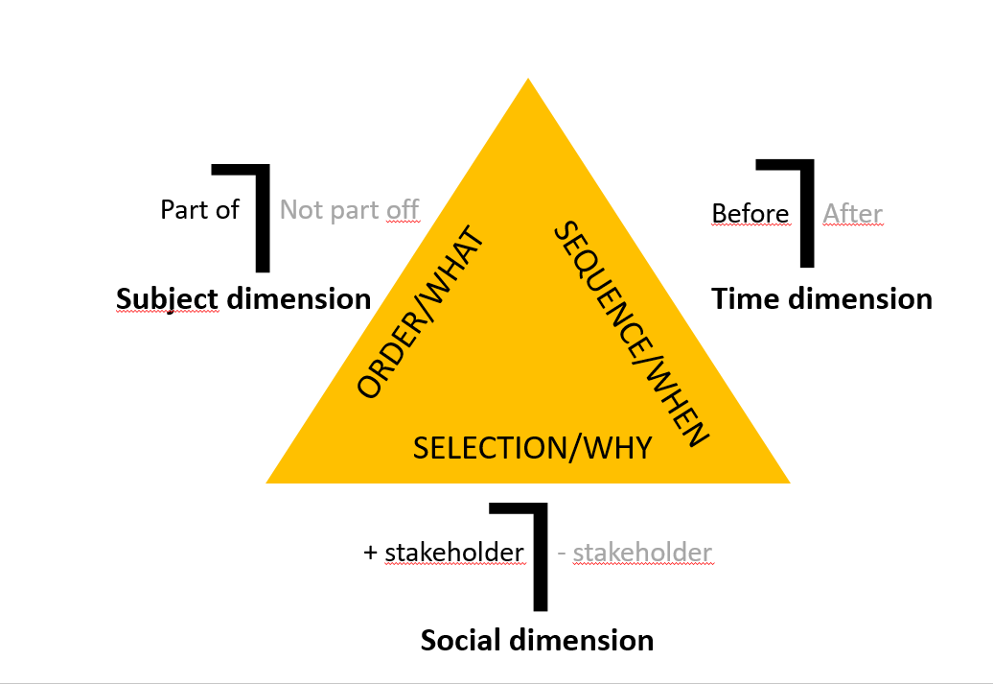
The Aim and content: core question of curriculum
The hard one:
The discussion part/not part of can be very intense.
- the balance between tradition and future
power and position between research areas /groups
Professional/personal identity
- “wearing a bulletproof vest”
Decisions indicate where the subject should be placed in the curriculum but not how

Slide 9
Part of + mandatory for all Integrated or/and distributed approach

Slide 10
Part of + elective for some Elective in or across programs
Digital Competency
10 ECTS

Slide 11
Not a part of – do it if you want Extra -curricula

Slide 13
Different approaches – different difficulties and opportunities
All approaches have pro and cons
Coherence and coordination between fully integrated elements?
Links between distributed elements and the rest of the curriculum?
Can the status of the digital competences be explained /justified to… ?
Are the skills at hand in the academic community?
Sustainability and continuity: enough students for electives/extra-curricular?
If cross-curricular electives: do they fit “our” students’?
And
And

Slide 14
Welcome to Niels!

